Slide 1
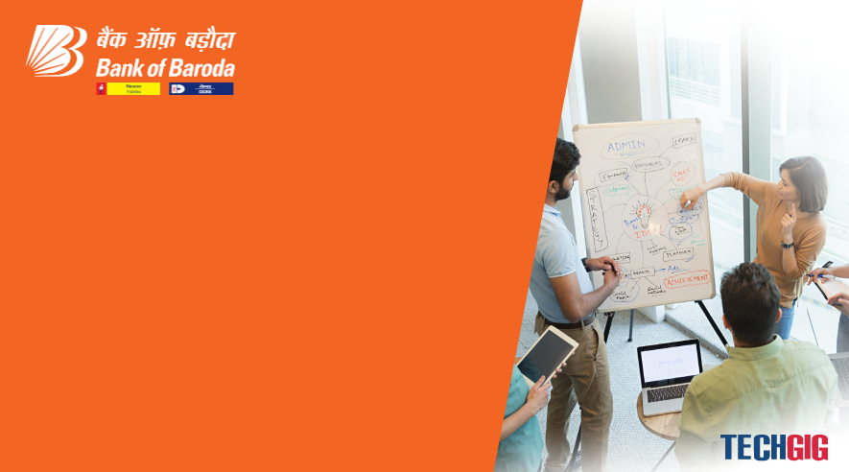

Bank of Baroda Hackathon - 2022
Technology Partner
Your Team Name : Technophiles
Your team bio :
Date :

Slide 2
Problem Statement?
Why did you decide to solve this Problem statement?
Despite rapid advancements in digital technology, financial institutions continue to rely on the traditional method of processing bank cheques by humans which is a tedious and time consuming task. This affects the end users as the transactions may take upto a few days to reflect in the bank accounts.
Moreover, relying just on physical means for processing large quantities of data can also be less efficient and prone to security breaches. This also accumulates to the total costs and resources for executing the process.
Digitalising this can also help in getting statistical analysis on the number of transactions and build models accordingly for the bank to work better.
So we believe that this model that we propose here will bring up the efficiency and performance of the same to a whole new level and hence this problem statement pleases us the most.

Slide 3
User Segment & Pain Points
Which user /advertiser segment would be early adopter of your product & why?
Smaller organizations can implement this product better in the testing stages so that the model can be further trained for better accuracy and speed.
This product will be mainly used by the banks for an efficient way to process cheques and also save time so that, more clients can approach the bank on a daily basis. This will improve the number of clients and thereby making the bank or organization more trustworthy.
Banks like Bank of Baroda which takes in a large amount of cheques can use this product to increase the cheque processing capabilities and in turn help the bank to earn more and provide better offers (to be corrected) for its clients.

Slide 4
Pre-Requisite
What are the alternatives/competitive products for the problem you are solving?
There are automated systems which extract relevant details of a bank cheque like Payee Name, Amount, Date, Bank Name using Optical Character Recognition and Deep Learning and verify the signature on the cheque with the existing signature stored in the database using feature extraction and principal component analysis.
It makes use of modified convolution neural network to extract the handwritten content on cheque leaf where in IAM dataset is used to train the model and get the optimized results.

Slide 5
Azure tools or resources
Azure tools or resources which are likely to be used by you for the prototype, if your idea gets selected
→GitHub
→VS Code
→Microsoft Excel
→ Microsoft Azure AI : Computer vision
→ Microsoft Azure AI - Machine Learning
→Microsoft Azure AI - Natural Language Processing
→Azure Form Recogniser
→Translator

Slide 6
Any Supporting Functional Documents
Present your solution, talk about methodology, architecture & scalability
Firstly, the the cheque leaf is scanned and the image is stored. Then, this image is used for the validation process.
The Account Number on the cheque is checked with the database of accounts. Then the parameters like Name, Amount (both in words and digits) and date (only 3 months validity) are extracted.
Following are the steps and features of the validation process:
→ Setting up the position
→ Multilingualism (Extracting data written in different regional languages)
→ Handwriting recognising efficiency
→ Signature verification
→ Validating the MICR number
→ Checking whether it is an A/C payee (A text written in the top left corner)

Slide 7
Key Differentiators & Adoption Plan
How is your solution better than alternatives and how do you plan to build adoption?

Slide 8
GitHub Repository Link & supporting diagrams, screenshots, if any
How far it can go?
Flowchart : https://cloud.smartdraw.com/share.aspx/?pubDocShare=1E3C1FF9C3814A71457C18680B4B5FAEC93
Notion Workspace : https://festive-dive-9e1.notion.site/BoB-Hackathon-38bb5a2169014eb99e8abedffaea35cd
GitHub : https://github.com/AshiqNoor-S/Team-Technophiles

Slide 9
Thank You
Team member names:
Ashiq Noor Sudheer
Bharat P
Mathew Thomas
Priyanshu Pattanaik

